Slide 1



Spinors For Beginners
10
$$SU(2)$$
double
$$SO(3)$$
covers

Slide 2
Spinors Learning “Staircase”
Spinors in Particle Physics
Lie Groups & Algebras
Clifford Algebras
Spinors in 3D / (4D)
Examples From Physics (motivation)

Slide 3
Spinors Learning “Staircase”
Double Cover
Spin Group
Spinors in Particle Physics
Lie Groups & Algebras
Clifford Algebras
Spinors in 3D / (4D)
Examples From Physics (motivation)

Slide 4
Spinors Learning “Staircase”
Spinors in Particle Physics
(Geometric Algebras)
Lie Groups & Algebras
Clifford Algebras
Spinors in 3D / (4D)
Examples From Physics (motivation)

Slide 5
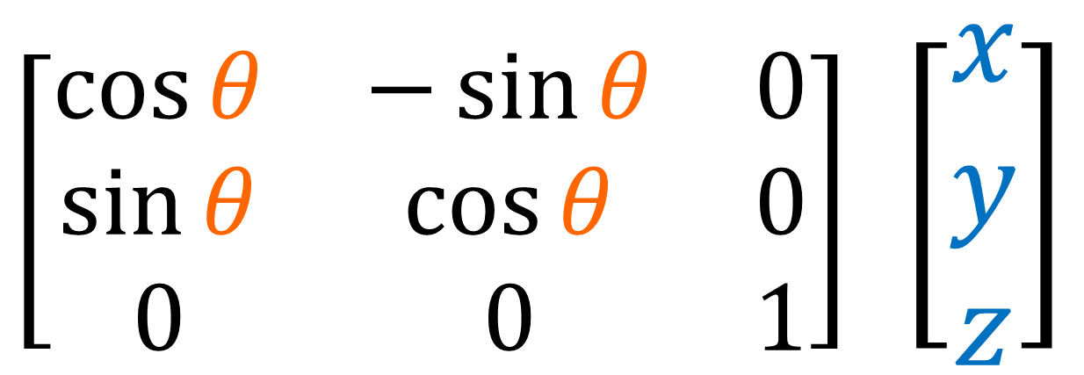



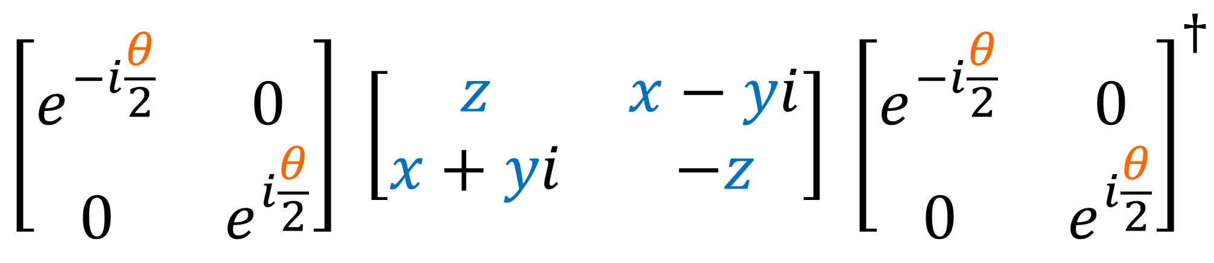
$$SO(3)$$
3D Vector
Rotation
$\left[\begin{matrix}\cos{θ} & −\sin{θ} & 0 \\ \sin{θ} & \cos{θ} & 0 \\ 0 & 0 & 1\end{matrix}\right]$ $\left[\begin{aligned}x \\ y \\ z\end{aligned}\right]$
$$SU(2)$$
$$SU(2)$$
Pauli Vector
$$\left[\begin{matrix}e^{−i\frac{θ}{2}} & 0 \\ 0 & e^{i\frac{θ}{2}}\end{matrix}\right] \left[\begin{matrix}z & x−yi \\ x+yi & −z\end{matrix}\right] {\left[\begin{matrix}e^{−i\frac{θ}{2}} & 0 \\ 0 & e^{i\frac{θ}{2}}\end{matrix}\right]}^{†}$$

Slide 6

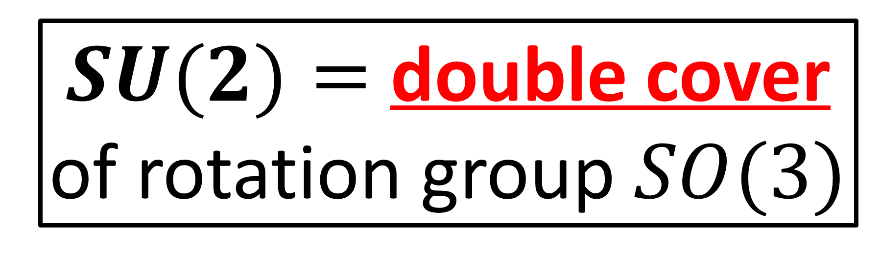

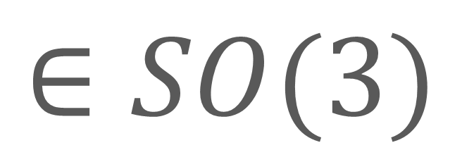
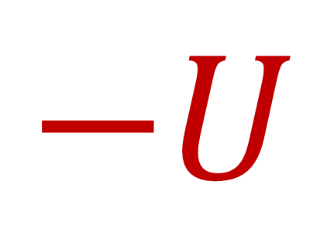
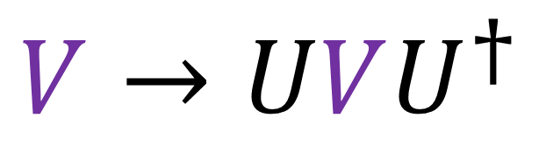

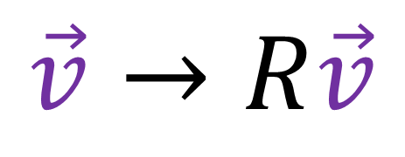

$SU(2)=$ double cover of rotation group $SO(3)$
$$+U$$
$$∈SU(2)$$
$$R$$
$$∈SO(3)$$
$$−U$$
$$∈SU(2)$$
$$\vec{v}→R\vec{v}$$
$$V→UVU^{†}$$

Slide 7
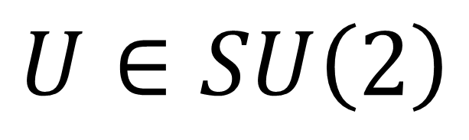
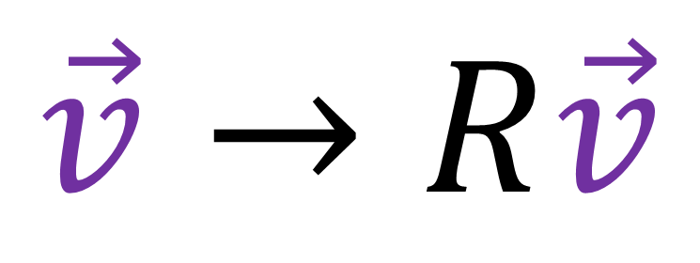
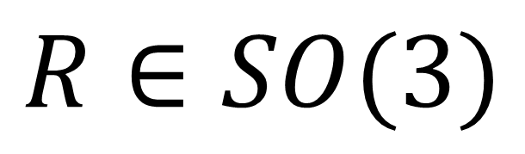
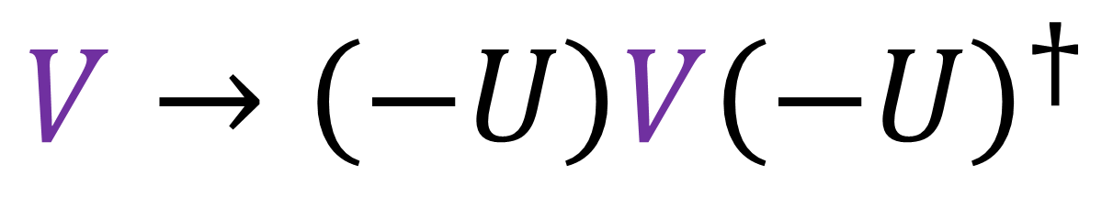
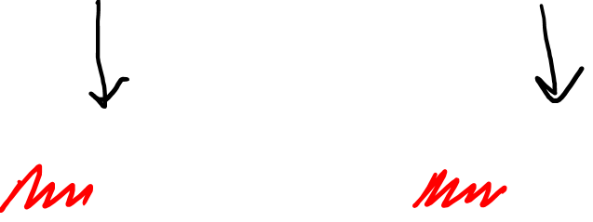
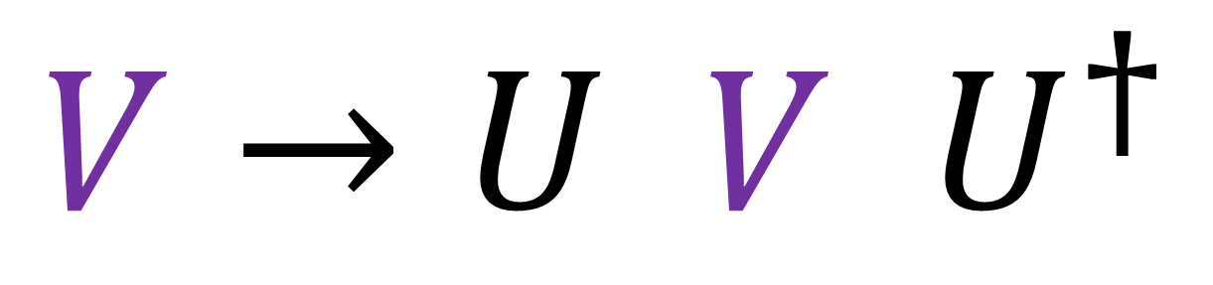
$SU(2)=$ double cover of rotation group $SO(3)$
$$R∈SO(3)$$
$$U∈SU\left(2\right)$$
$$\vec{v}→R\vec{v}$$
$$V→U V U^{†}$$
$$V→\left(−U\right)V{\left(−U\right)}^{†}$$

Slide 8
$SU(2)=$ double cover of rotation group $SO(3)$
$$+U$$
$$∈SU(2)$$
$$R$$
$$∈SO(3)$$
$$−U$$
$$∈SU(2)$$
$$\vec{v}→R\vec{v}$$
$$V→UVU^{†}$$

Slide 9
Double-Cover has Topological interpretation

Slide 10
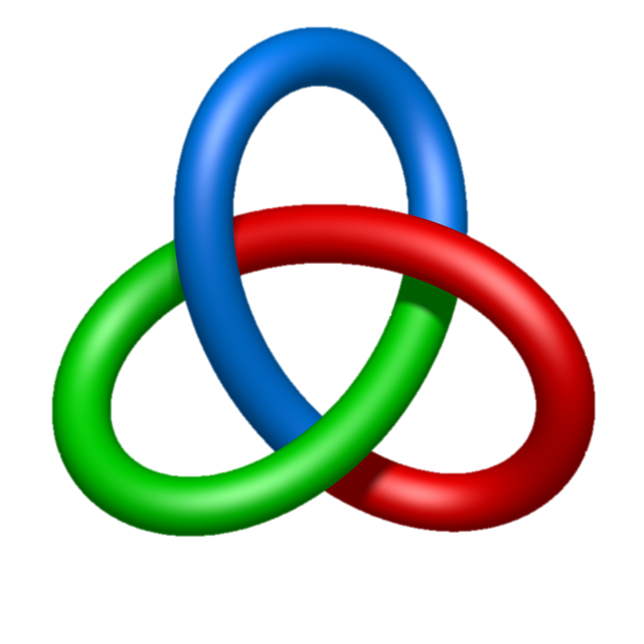

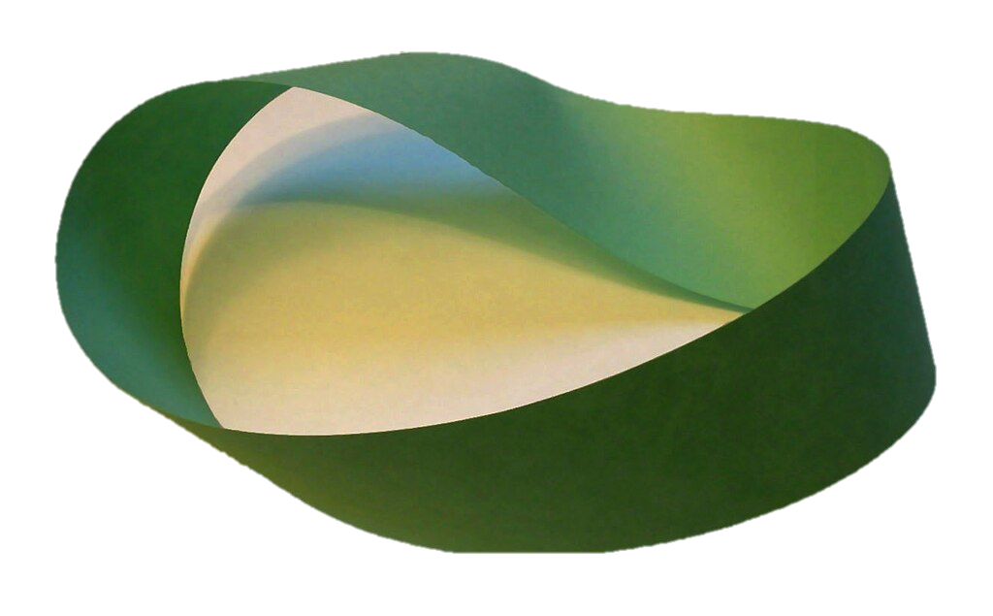
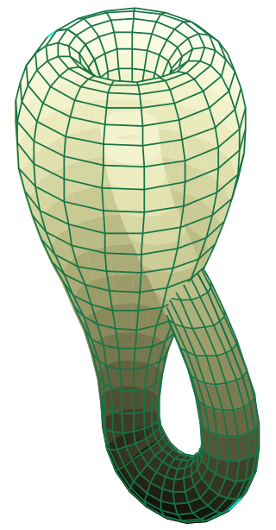


Topology = “Rubber Sheet Geometry”
Images from Wikipedia articles on mobius strip, klein bottle, sphere, knot theory, homeomorphism

Slide 11
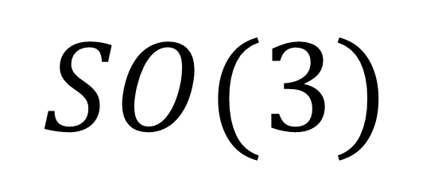




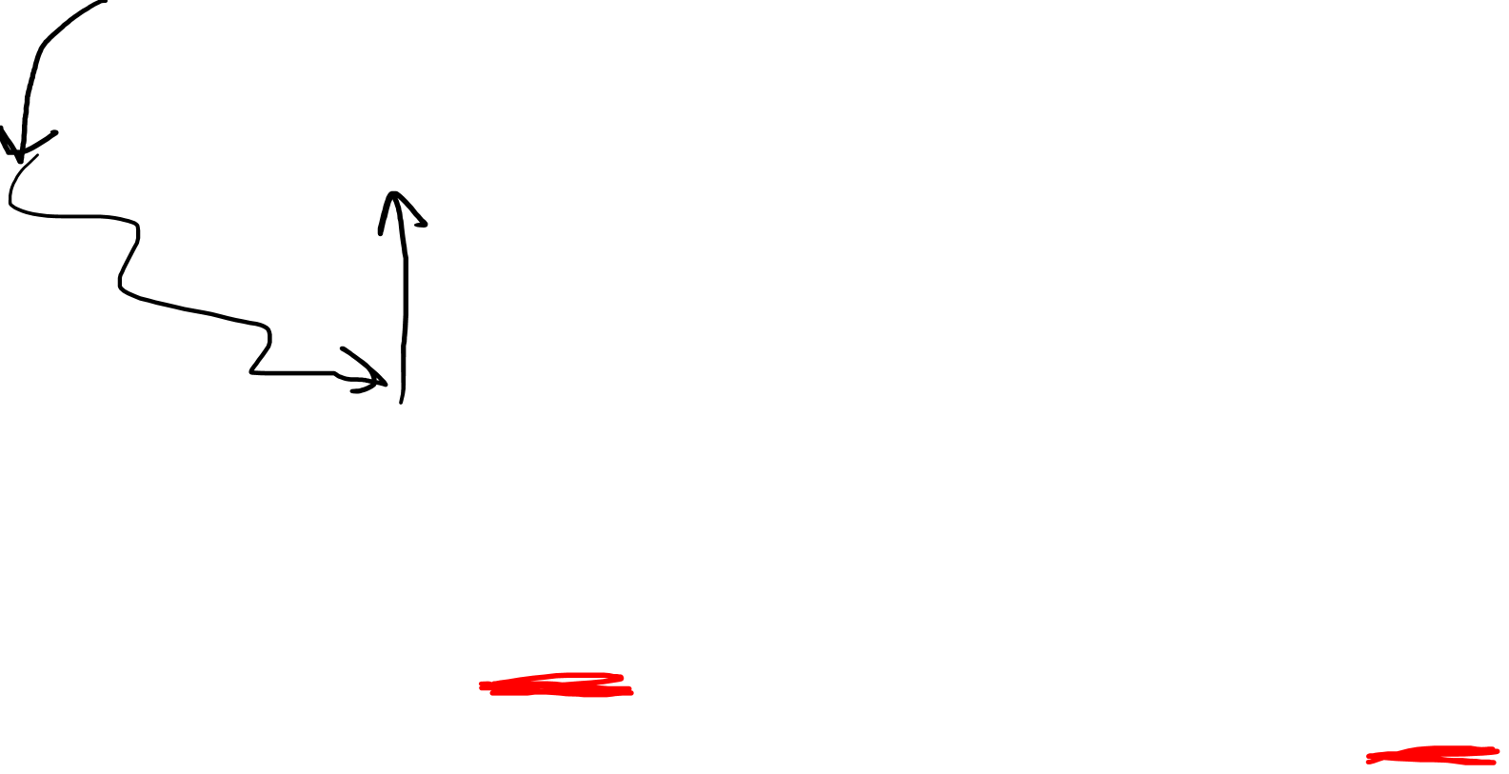
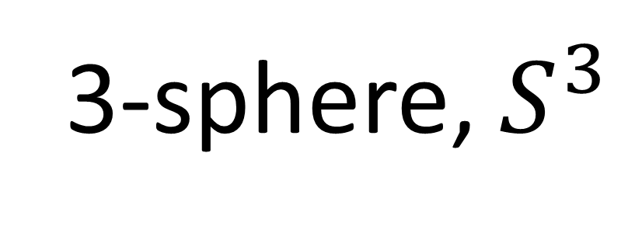



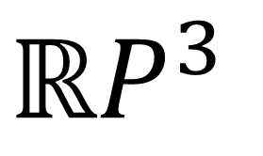
$$SO(3)$$
simplified view
$$SU(2)$$
simplified view
$$χ$$
$$χ$$
$$φ$$
$$θ$$
$$φ$$
$$θ$$
$$ℝP^{3}$$
3-sphere, $S^{3}$
Real Projective 3-space

Slide 12
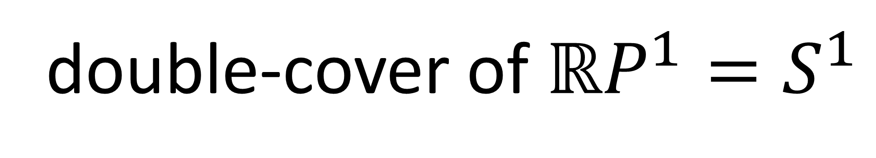
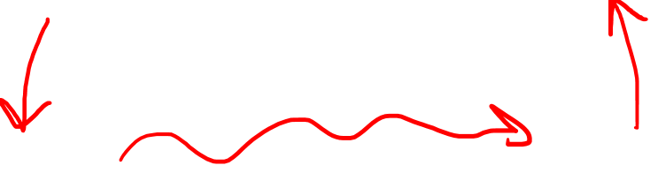

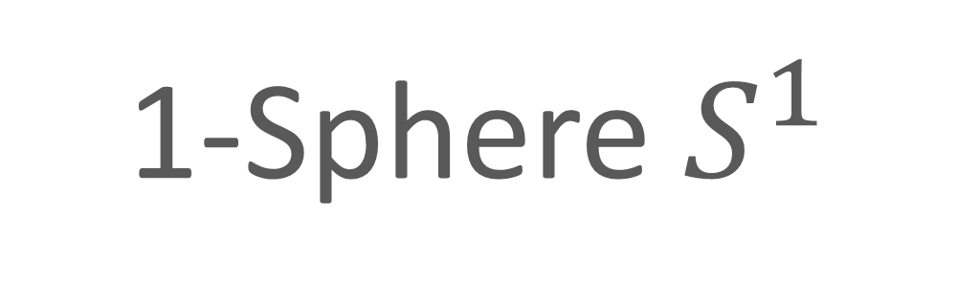
double-cover of $ℝP^{1}=S^{1}$
Real Projective Line $ℝP^{1}$
1-Sphere $S^{1}$

Slide 13
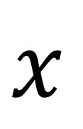
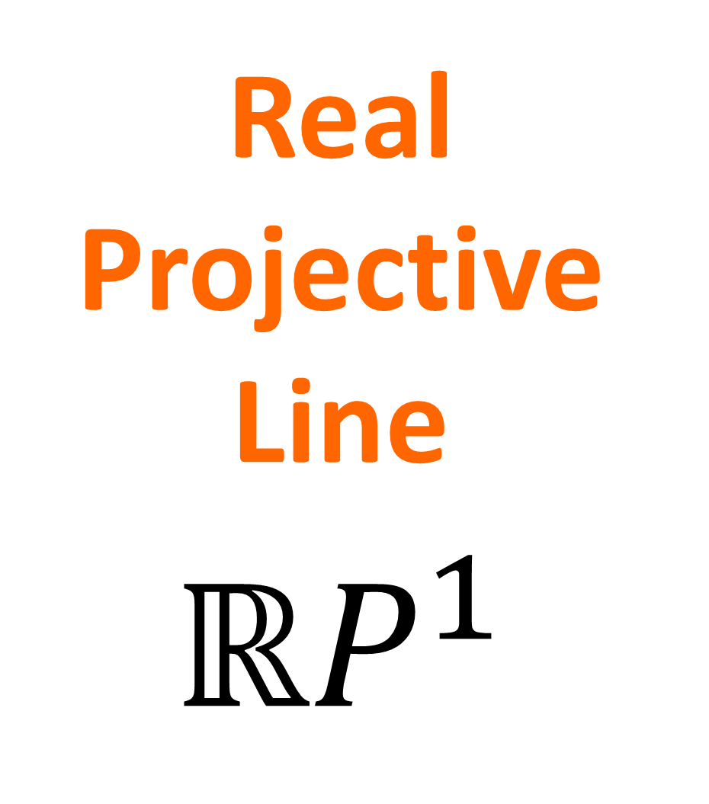
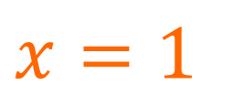
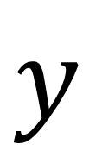
Perspective Projection (Video #5)
$y$
Real Projective Line
$$ℝP^{1}$$
$x$
$x=1$

Slide 14
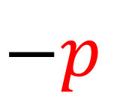
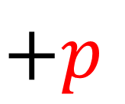
Perspective Projection (Video #5)
$y$
$$+p$$
$$−p$$
$x=1$

Slide 15

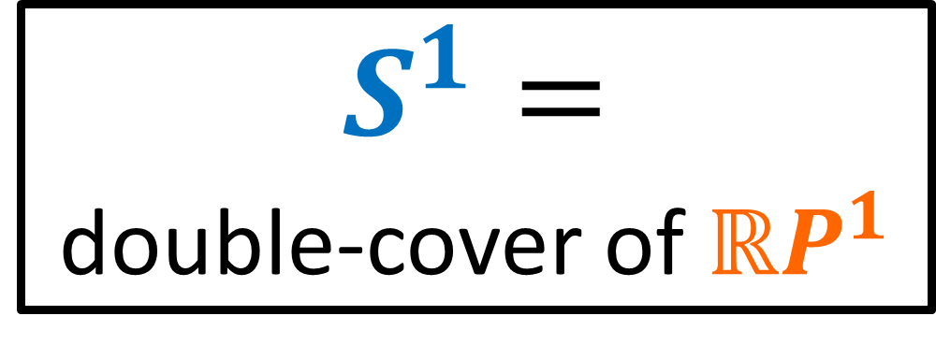
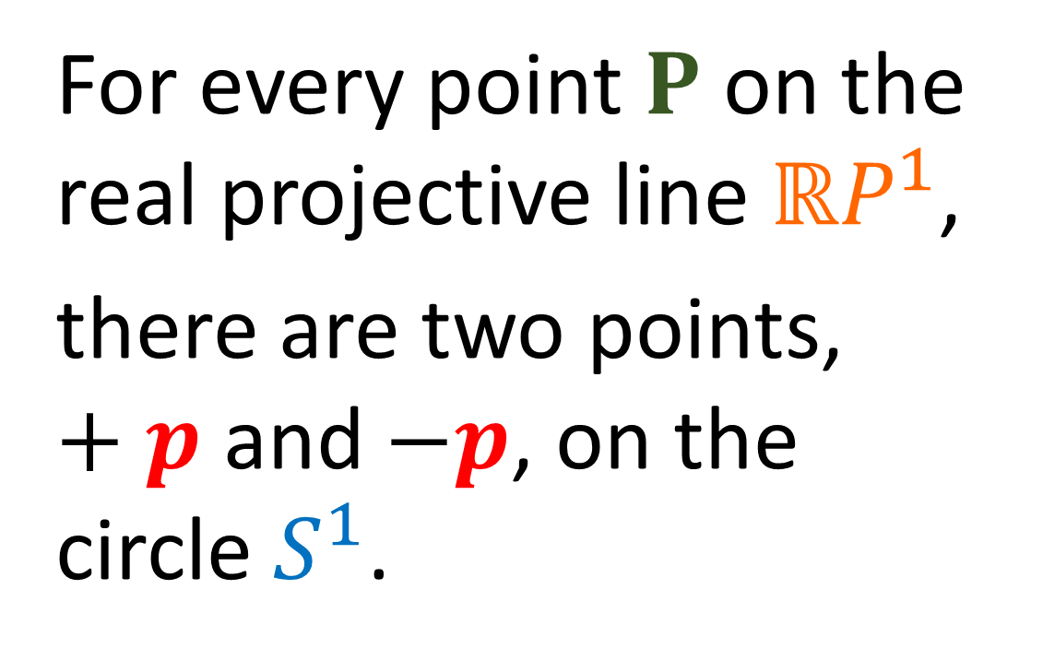
Perspective Projection (Video #5)
$y$
For every point $P$ on the real projective line $ℝP^{1}$,
there are two points, $+p$ and $−p$, on the circle $S^{1}$.
$$+p$$
$$P$$
$S^{1}=$
double-cover of $ℝP^{1}$
$$−p$$
$x=1$

Slide 16
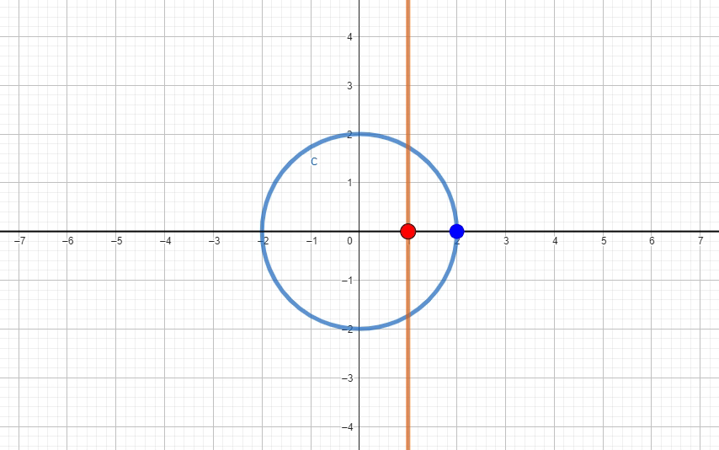

Slide 17
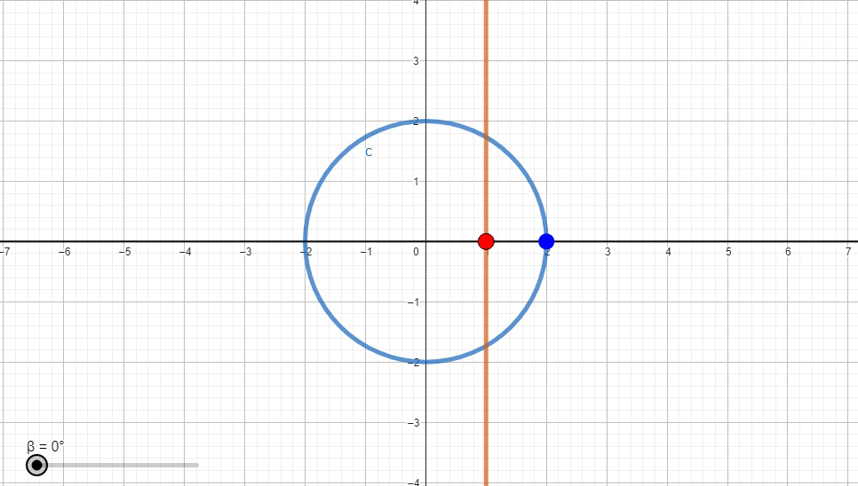

Slide 18
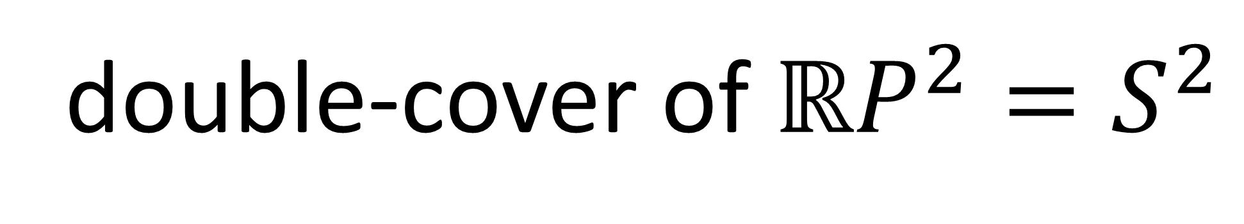
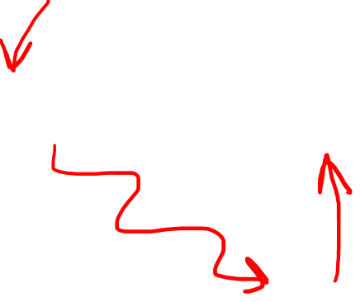


double-cover of $ℝP^{2}=S^{2}$
Real Projective Plane $ℝP^{2}$
2-Sphere $S^{2}$

Slide 19
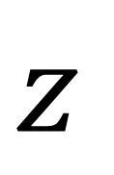
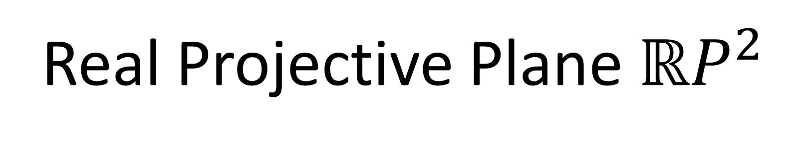
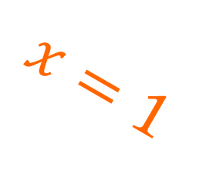
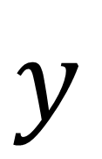
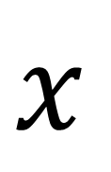

Real Projective Plane $ℝP^{2}$
$y$
Real Projective Plane
$$ℝP^{2}$$
$x$
$z$
$x=1$

Slide 20
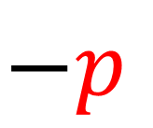
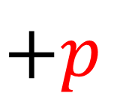
Real Projective Plane $ℝP^{2}$
$$+p$$
$y$
$x$
$z$
$$−p$$
$x=1$

Slide 21
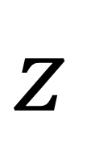
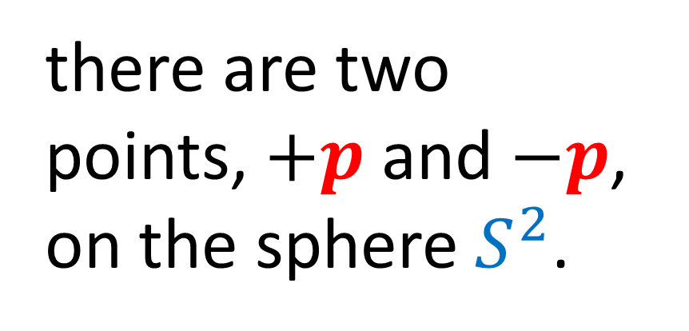
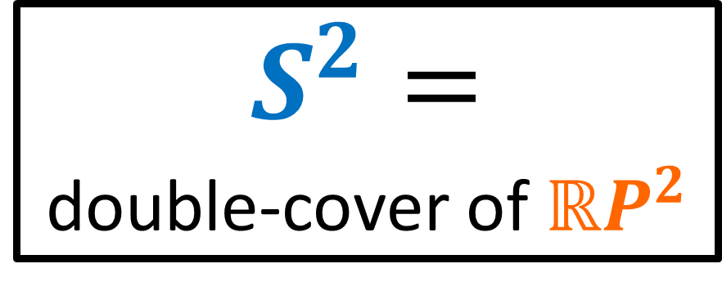
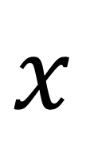
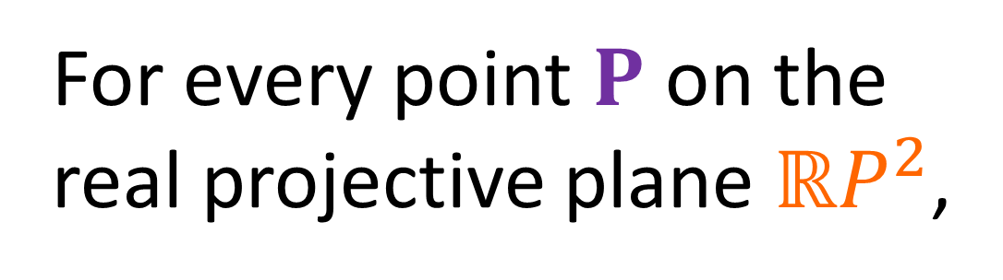

Real Projective Plane $ℝP^{2}$
$$+p$$
$y$
For every point $P$ on the real projective plane $ℝP^{2}$,
$$P$$
there are two points, $+p$ and $−p$, on the sphere $S^{2}$.
$x$
$S^{2}=$
double-cover of $ℝP^{2}$
$$−p$$
$z$
$x=1$

Slide 22
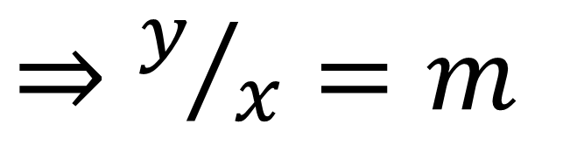
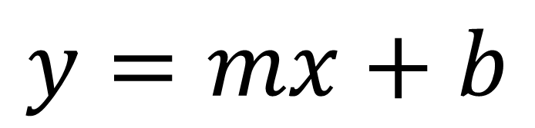
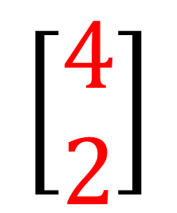





Real Projective Plane $ℝP^{1}$
$y$
$$y=mx+b$$
$⇒y/x=m$
$x$
$$\left[\begin{aligned}2 \\ 1\end{aligned}\right]$$
$$\left[\begin{aligned}3 \\ 1.5\end{aligned}\right]$$
$$\left[\begin{aligned}4 \\ 2\end{aligned}\right]$$
$y/x=1/2$
$x=1$

Slide 23






Real Projective Plane $ℝP^{1}$
$y$
$$y=mx+b$$
$⇒y/x=m$
$x$
$$\left[\begin{aligned}2 \\ 1\end{aligned}\right]$$
$$\left[\begin{aligned}3 \\ 1.5\end{aligned}\right]$$
$$\left[\begin{aligned}4 \\ 2\end{aligned}\right]$$
$$\left[\begin{aligned}1 \\ y/x\end{aligned}\right]$$
$$\left[\begin{aligned}1 \\ 1/2\end{aligned}\right]$$
$$\left[\begin{aligned}1 \\ m\end{aligned}\right]$$
$$=$$
$$=$$
$x=1$

Slide 24






double-cover of $ℝP^{3}=S^{3}$
$?$
$?$
$$x^{2}+y^{2}+z^{2}+w^{2}=1$$
Real Projective Space $ℝP^{3}$
3-Sphere $S^{3}$

Slide 25






Real Projective Plane $ℝP^{2}$
$y$
$ℝP^{2}$ points defined by:
$$y/x,z/x$$
$$\left[\begin{aligned}2 \\ 3 \\ 1\end{aligned}\right]$$
$$\left[\begin{aligned}3 \\ 4.5 \\ 1.5\end{aligned}\right]$$
$$\left[\begin{aligned}4 \\ 6 \\ 2\end{aligned}\right]$$
$x$
$$⇒\left[\begin{aligned}1 \\ y/x \\ z/x\end{aligned}\right]=\left[\begin{aligned}1 \\ 1.5 \\ 0.5\end{aligned}\right]$$
$z$
$x=1$

Slide 26


double-cover of $ℝP^{3}=S^{3}$
$\left[\begin{aligned}x \\ y \\ z \\ w\end{aligned}\right]→$ $\left[\begin{aligned}1 \\ y/x \\ z/x \\ w/x\end{aligned}\right]$
$$x^{2}+y^{2}+z^{2}+w^{2}=1$$
Real Projective Space $ℝP^{3}$
3-Sphere $S^{3}$

Slide 27


double-cover of $ℝP^{3}=S^{3}$
double-cover of $SO\left(3\right)=SU\left(2\right)$

Slide 28







$$U∈SU\left(2\right)$$
$U^{†}=U^{−1}$
$\det\left(U\right)=1$
What do $SU\left(2\right)$ matrices look like?
$$U=\left[\begin{matrix}α & γ \\ β & δ\end{matrix}\right]$$
$$δ=α^{∗}$$
$$γ=−β^{∗}$$
$U^{†}=\left[\begin{matrix}α^{∗} & β^{∗} \\ γ^{∗} & δ^{∗}\end{matrix}\right]$
$U^{−1}=\frac{1}{\det{U}}\left[\begin{matrix}δ & −γ \\ −β & α\end{matrix}\right]$

Slide 29


$$U=\left[\begin{matrix}α & −β^{∗} \\ β & α^{∗}\end{matrix}\right]$$
$$U∈SU\left(2\right)$$
$U^{†}=U^{−1}$
$\det\left(U\right)=1$
$$\det\left(U\right) =1$$
$$αα^{∗}−\left(−β^{∗}\right)β=1$$
$${\left|α\right|}^{2} + {\left|β\right|}^{2} =1$$

Slide 30

$$U=\left[\begin{matrix}α & −β^{∗} \\ β & α^{∗}\end{matrix}\right]$$
$$U∈SU\left(2\right)$$
$U^{†}=U^{−1}$
$\det\left(U\right)=1$
${\left|α\right|}^{2} + {\left|β\right|}^{2} =1$
$${\left|a+ib\right|}^{2}+{\left|c+id\right|}^{2} =1$$
$$a^{2}+ b^{2} + c^{2} + d^{2}=1$$

Slide 31







$$a^{2}+ b^{2} + c^{2} + d^{2}=1$$
$$c$$
$$U=\left[\begin{matrix}α & −β^{∗} \\ β & α^{∗}\end{matrix}\right]$$
$$b$$
$$α=a+ib$$
$$β=c+id$$
$$d$$
$$a$$

Slide 32




$$a^{2}+ b^{2} + c^{2} + d^{2}=1$$
$$c$$
Free to Specify
$$χ$$
Determined
$$b$$
3 free parameters:
Rotation in $xy$-plane
Rotation in $yz$-plane
Rotation in $zx$-plane
$$φ$$
$$d$$
$$θ$$
$$a$$

Slide 33
$SU(2)=$ double cover of rotation group $SO(3)$
$$+U$$
$$∈SU(2)$$
$$R$$
$$∈SO(3)$$
$$−U$$
$$∈SU(2)$$
$$\vec{v}→R\vec{v}$$
$$V→UVU^{†}$$

Slide 34
$SU(2)=$ double cover of rotation group $SO(3)$
$$R∈SO(3)$$
$$U∈SU\left(2\right)$$
$$\vec{v}→R\vec{v}$$
$$V→U V U^{†}$$
$$V→\left(−U\right)V{\left(−U\right)}^{†}$$

Slide 35








$$S^{3}=SU\left(2\right)$$
$$ℝP^{3}=$$
$$SO\left(3\right)$$
$y$
$$+U$$
$$R$$
$x$
$$−U$$
$z$

Slide 36


Topology:
(unit quaternions)
$SU\left(2\right)⇒$ simply connected
$SO\left(3\right)⇒$ NOT simply connected

Slide 37





Simply connected = no “holes”/“handles”
Simply Connected
NOT Simply Connected
(Images from Wikipedia)

Slide 38




All $n$-spheres $S^{n}$ (for $n≥2$) are simply connected.
(quaternions)
$S^{3}=SU(2)$ is simply-connected!
Exception: 1-sphere $S^{1}$ (circle) is NOT simply-connected

Slide 39


Real projective space${ℝP}^{n}$ are NOT simply connected.
${ℝP}^{3}=SO(3)$ is NOT simply-connected!
Equivalent

Slide 40











$$θ_{z}$$
Euler Angles: $\left(θ_{x},θ_{y},θ_{z}\right)$
$$z$$
$$θ_{y}$$
$$θ_{x}$$
$$θ_{y}$$
$$θ_{z}$$
$$y$$
$$x$$
$$θ_{x}$$

Slide 41










$$θ_{y}$$
$$θ_{x}$$
$$θ_{y}$$
$$θ_{x}$$

Slide 42




$$θ_{z}$$
Euler Angles: $\left(θ_{x},θ_{y},θ_{z}\right)$
$$z$$
$$θ_{y}$$
$$θ_{x}$$
$$θ_{y}$$
$$θ_{z}$$
$$y$$
$$x$$
$$θ_{x}$$

Slide 43













$$z$$
$$i$$ | $$↔$$ | $$−σ_{y}σ_{z}$$
$$y$$
$$x$$
$$i$$
$$z$$
$$j$$
$$j$$ | $$↔$$ | $$−σ_{z}σ_{x}$$
$$y$$
$$k$$
$$x$$
$$z$$
$$y$$
$$k$$ | $$↔$$ | $$−σ_{x}σ_{y}$$
$$x$$

Slide 44





$SU(2)$ matrices
= double-cover of $SO(3)$
$$=\left(+q\right)v{\left(+q\right)}^{∗}=\left(−q\right)v{\left(−q\right)}^{∗}$$
$$≈R\vec{v}$$
$$=\left(+U\right)V{\left(+U\right)}^{†}=\left(−U\right)V{\left(−U\right)}^{†}$$

Slide 45








Rotate 3D vector with
$SO(3)$ Matrices
Rotate 3D vector with
$SU(2)$ Matrices
$$V→UVU^{†}$$
$$\vec{v}→R\vec{v}$$
$$V→\left(−U\right)V{\left(−U\right)}^{†}$$
$$R^{−1}=R^{T}$$
$$\det{R}=+1$$
$$U^{−1}=U^{†}$$
$$\det{U}=+1$$

Slide 46





$SU(2)$ Matrix
$SU(2)$ Matrix
Pauli Vector
$\left[\begin{matrix}e^{−i\frac{θ}{2}} & 0 \\ 0 & e^{i\frac{θ}{2}}\end{matrix}\right]$ $\left[\begin{matrix}z & x−yi \\ x+yi & −z\end{matrix}\right]$ ${\left[\begin{matrix}e^{−i\frac{θ}{2}} & 0 \\ 0 & e^{i\frac{θ}{2}}\end{matrix}\right]}^{†}$
Quaternions:
$$q \vec{v} q^{∗}$$

Slide 47



(proper orthochronous) Lorentz Transformations:
$$Λ∈SO^{+}\left(1,3\right)$$
Keeps spacetime interval constant:
$s^{2}={\left(ct\right)}^{2}−x^{2}−y^{2}−z^{2}$
No spatial reflections: $det\left(Λ\right)=+1$
No temporal reflections: $Λ_{0}^{0}>0$

Slide 48





$$\left[\begin{matrix}\begin{matrix}\begin{aligned}1 \\ 0 \\ 0 \\ 0\end{aligned} & \begin{aligned}0 \\ 1 \\ 0 \\ 0\end{aligned}\end{matrix} & \begin{matrix}\begin{aligned}0 \\ 0 \\ 1 \\ 0\end{aligned} & \begin{aligned}0 \\ 0 \\ 0 \\ 1\end{aligned}\end{matrix}\end{matrix}\right]\left[\begin{aligned}ct \\ x \\ y \\ z\end{aligned}\right]$$
4D
Spacetime Vector
$$SO^{+}(1,3)$$
Weyl Vector
$$\left[\begin{matrix}e^{−iθ} & 0 \\ 0 & e^{iθ}\end{matrix}\right] \left[\begin{matrix}ct+z & x−yi \\ x+yi & ct−z\end{matrix}\right] {\left[\begin{matrix}e^{−iθ} & 0 \\ 0 & e^{iθ}\end{matrix}\right]}^{†}$$
$$SL(2,ℂ)$$
$$SL(2,ℂ)$$

Slide 49









$SL(2,ℂ)=$ double cover of rotation group $SO^{+}(1,3)$
$$+L$$
$$∈SL(2,ℂ)$$
$$Λ$$
$$∈SO^{+}(1,3)$$
$$−L$$
$$∈SL(2,ℂ)$$
$$\vec{w}→Λ\vec{w}$$
$$W→LWL^{†}$$

Slide 50






$SL(2,ℂ)=$ double cover of rotation group $SO^{+}(1,3)$
$$Λ∈SO^{+}(1,3)$$
$$L∈SL(2,ℂ)$$
$$\vec{w}→Λ\vec{w}$$
$$W→L W L^{†}$$
$$W→\left(−L\right)W{\left(−L\right)}^{†}$$

Slide 51







$$SO^{+}(1,1)$$
$$SO(2)$$
$$s^{2}={\left(ct\right)}^{2}−x^{2}$$
$$r^{2}=x^{2}+y^{2}$$
$$\left[\begin{matrix}\cosh{φ} & \sinh{φ} \\ \sinh{φ} & \cosh{φ}\end{matrix}\right]$$
$$\left[\begin{matrix}\cos{θ} & \sin{θ} \\ \sin{θ} & \cos{θ}\end{matrix}\right]$$
$$ct$$
$$y$$
$$x$$
$$x$$

Slide 52












$$SO^{+}(1,2)$$
$$SO(3)$$
$$s^{2}={\left(ct\right)}^{2}−x^{2}−y^{2}$$
$$r^{2}=x^{2}+y^{2}+z^{2}$$
$$\left[\begin{matrix}\cosh{φ} & \sinh{φ} & 0 \\ \sinh{φ} & \cosh{φ} & 0 \\ 0 & 0 & 1\end{matrix}\right]$$
$$\left[\begin{matrix}\cos{θ} & −\sin{θ} & 0 \\ \sin{θ} & \cos{θ} & 0 \\ 0 & 0 & 1\end{matrix}\right]$$
$$ct$$
$$z$$
Symmetries of:
Symmetries of:
$$y$$
$$y$$
$$x$$
$$x$$

Slide 53






$$SO^{+}(1,3)$$
$$SO(4)$$
$$s^{2}={\left(ct\right)}^{2}−x^{2}−y^{2}−z^{2}$$
$$r^{2}=x^{2}+y^{2}+z^{2}+w^{2}$$
$$\left[\begin{matrix}\begin{matrix}\begin{aligned}\cosh{φ} \\ \sinh{φ} \\ 0 \\ 0\end{aligned} & \begin{aligned}\sinh{φ} \\ \cosh{φ} \\ 0 \\ 0\end{aligned}\end{matrix} & \begin{matrix}\begin{aligned}0 \\ 0 \\ 1 \\ 0\end{aligned} & \begin{aligned}0 \\ 0 \\ 0 \\ 1\end{aligned}\end{matrix}\end{matrix}\right]$$
$$\left[\begin{matrix}\begin{matrix}\begin{aligned}\cos{θ} \\ \sin{θ} \\ 0 \\ 0\end{aligned} & \begin{aligned}−\sin{θ} \\ \cos{θ} \\ 0 \\ 0\end{aligned}\end{matrix} & \begin{matrix}\begin{aligned}0 \\ 0 \\ 1 \\ 0\end{aligned} & \begin{aligned}0 \\ 0 \\ 0 \\ 1\end{aligned}\end{matrix}\end{matrix}\right]$$
Symmetries of hyperboloid:
3 boosts
3 rotations
Symmetries of sphere:
6 rotations

Slide 54








$SL\left(2,ℂ\right)=$ double cover of $SO^{+}(1,3)$
Bloch Sphere
$\left[\begin{matrix}e^{−iθ/2} & 0 \\ 0 & e^{iθ/2}\end{matrix}\right]$
$$\left|+z\right\rangle$$
$\left[\begin{matrix}\cos{θ/2} & −\sin{θ/2} \\ \sin{θ/2} & \cos{θ/2}\end{matrix}\right]$
$$\left|−x\right\rangle$$
$\left[\begin{matrix}\cos{θ/2} & −i\sin{θ/2} \\ −i\sin{θ/2} & \cos{θ/2}\end{matrix}\right]$
$$\left|−y\right\rangle$$
$$\left|+y\right\rangle$$
$\left[\begin{matrix}\cosh{φ/2} & −\sinh{φ/2} \\ −\sinh{φ/2} & \cosh{φ/2}\end{matrix}\right]$
$$\left|+x\right\rangle$$
$\left[\begin{matrix}\cosh{φ/2} & i\sinh{φ/2} \\ −i\sinh{φ/2} & \cosh{φ/2}\end{matrix}\right]$
$$\left|−z\right\rangle$$
Spinor
$\left[\begin{matrix}e^{−φ/2} & 0 \\ 0 & e^{+φ/2}\end{matrix}\right]$
$$\left[\begin{aligned}α \\ β\end{aligned}\right]→α\left|+z\right\rangle +β\left|−z\right\rangle$$

Slide 55






$SL\left(2,ℂ\right)=$ double cover of $SO^{+}(1,3)$
$\left[\begin{matrix}e^{−iθ/2} & 0 \\ 0 & e^{iθ/2}\end{matrix}\right]$
$\left[\begin{matrix}\cos{θ/2} & −\sin{θ/2} \\ \sin{θ/2} & \cos{θ/2}\end{matrix}\right]$
Rotations
$\left[\begin{matrix}\cos{θ/2} & −i\sin{θ/2} \\ −i\sin{θ/2} & \cos{θ/2}\end{matrix}\right]$
$\left[\begin{matrix}\cosh{φ/2} & −\sinh{φ/2} \\ −\sinh{φ/2} & \cosh{φ/2}\end{matrix}\right]$
$\left[\begin{matrix}\cosh{φ/2} & i\sinh{φ/2} \\ −i\sinh{φ/2} & \cosh{φ/2}\end{matrix}\right]$
Boosts
$\left[\begin{matrix}e^{−φ/2} & 0 \\ 0 & e^{+φ/2}\end{matrix}\right]$

Slide 56





$SL\left(2,ℂ\right)=$ double cover of $SO^{+}(1,3)$
$$\left|+z\right\rangle$$
$\left[\begin{matrix}e^{−φ/2} & 0 \\ 0 & e^{+φ/2}\end{matrix}\right]$
Boost in $+z$ direction
$$\left|−z\right\rangle$$

Slide 57


$SL\left(2,ℂ\right)=$ double cover of $SO^{+}(1,3)$
$$\left|+z\right\rangle$$
$\left[\begin{matrix}e^{−φ/2} & 0 \\ 0 & e^{+φ/2}\end{matrix}\right]$
Boost in $+z$ direction
$$\left|−z\right\rangle$$

Slide 58



Stern-Gerlach Experiment (1922):
(S.G. experiment)
“spin iiup”
$$\left|↑\right\rangle$$
S
N
$$\left|↓\right\rangle$$
beam of neutral particles (e.g. silver atoms)
magnetic field
(inhomogeneous)
“spin down”

Slide 59






Bloch Sphere
Stern-Gerlach Experiment
$$\left\langle ψ|ξ\right\rangle =0$$
$$\left|ψ\right\rangle$$
$$\left|ψ\right\rangle$$
S
N
$$\left|ξ\right\rangle$$
$$\left|ξ\right\rangle$$

Slide 60



$SL\left(2,ℂ\right)=$ double cover of $SO^{+}(1,3)$
$$\left|+z\right\rangle$$
$\left[\begin{matrix}e^{−φ/2} & 0 \\ 0 & e^{+φ/2}\end{matrix}\right]$
$$\left|ψ\right\rangle$$
$$\left|ξ\right\rangle$$
Boost in $+z$ direction
$$\left|−z\right\rangle$$
$$\left\langle ψ|ξ\right\rangle =0$$

Slide 61



$SL\left(2,ℂ\right)=$ double cover of $SO^{+}(1,3)$
$$\left|+z\right\rangle$$
$\left[\begin{matrix}e^{−φ/2} & 0 \\ 0 & e^{+φ/2}\end{matrix}\right]$
$$\left|ψ\right\rangle$$
$$\left|ξ\right\rangle$$
Boost in $+z$ direction
$$\left|\tilde{ψ}\right\rangle$$
$$\left|\tilde{ξ}\right\rangle$$
$$\left|−z\right\rangle$$
$$\left\langle ψ|ξ\right\rangle =0$$
$$\left\langle \tilde{ψ}|\tilde{ξ}\right\rangle ≠0$$

Slide 62

Contradiction with Born’s Rule:
Probabilities are different in different (boosted) frames?
$$P\left(ψ→ξ\right)={\left|\left\langle ψ|ξ\right\rangle \right|}^{2}=0$$
$$P\left(\tilde{ψ}→\tilde{ξ}\right)={\left|\left\langle \tilde{ψ}|\tilde{ξ}\right\rangle \right|}^{2}≠0$$
Quantum Mechanics not compatible with Special Relativity?
Resolved in Quantum Field Theory (QFT).
In QFT, particles are “excitations” in fields.

Slide 63







Spin Groups:
$$SO(3)$$
$$=Spin(3)$$
double cover of
$$=SU(2)$$
$$=$$
unit quaternions
double cover of
$$SO^{+}(1,3)$$
$$=Spin(1,3)$$
$$=SL(2,ℂ)$$

Slide 64




$$\left[\begin{aligned}x \\ y \\ z\end{aligned}\right]$$
Pauli Vector (3D space)
$$→\left[\begin{matrix}z & x−yi \\ x+yi & −z\end{matrix}\right]$$
$$\left[\begin{aligned}ct \\ x \\ y \\ z\end{aligned}\right]$$
Weyl Vector (4D spacetime)
$$→\left[\begin{matrix}ct+z & x−yi \\ x+yi & ct−z\end{matrix}\right]$$

Slide 65










$$Spin(3)$$
$$Spin(3)$$
Pauli Vector
$$\left[\begin{matrix}e^{−iθ} & 0 \\ 0 & e^{iθ}\end{matrix}\right] \left[\begin{matrix}z & x−yi \\ x+yi & −z\end{matrix}\right] {\left[\begin{matrix}e^{−iθ} & 0 \\ 0 & e^{iθ}\end{matrix}\right]}^{†}$$
$$SU(2)$$
$$SU(2)$$
$$Spin(1,3)$$
$$Spin(1,3)$$
Weyl Vector
$$\left[\begin{matrix}e^{−iθ} & 0 \\ 0 & e^{iθ}\end{matrix}\right] \left[\begin{matrix}ct+z & x−yi \\ x+yi & ct−z\end{matrix}\right] {\left[\begin{matrix}e^{−iθ} & 0 \\ 0 & e^{iθ}\end{matrix}\right]}^{†}$$
$$SL(2,ℂ)$$
$$SL(2,ℂ)$$

Slide 66



For $n$-dimensional space…
rotation group $SO(n)$
double-cover $Spin(n)$
$Spin(3)$ = unit-length quaternions
$Spin(n)$ = generalization of unit
quaternions for $n$-dimensional space

Slide 67


For $(p,q)$-dimensional spacetime…
rotation/boost group $SO^{+}(p,q)$
double-cover $Spin(p,q)$
$Spin(p,q)$ = generalization of unit
quaternions for $(p,q)$-dimensional
spacetime

Slide 68

Systematic construction of $Spin(p,q)$ groups:
Done with Clifford Algebras.
(Geometric Algebras)

Slide 69









What are Clifford Algebras?
Generalization of:
quaternions $i j k$
complex numbers $i$
dirac matrices $γ_{t} γ_{x} γ_{y} γ_{Z}$
sigma matrices $σ_{x} σ_{y} σ_{z}$
Symbols square to $±1$:
$$i^{2}=−1$$
$${\left(σ_{x}\right)}^{2}=+1$$
Anti-commutative:
$$i j=−j i$$
$$σ_{x}σ_{y}=−σ_{y}σ_{x}$$

Slide 70

Scalars
Bivectors
Vectors
Linear Maps
Spinors

Slide 71
Clifford Algebras
Scalars
Bivectors
Vectors
Linear Maps
Spinors

Slide 72





Maxwell’s Equations
4-current
$∇⋅\vec{E}=\frac{ρ}{ε_{0}}$
$$∇F=μ_{0}cJ$$
$∇×\vec{E}=−\frac{∂\vec{B}}{∂t}$
$$∇⋅\vec{B}=0$$
Clifford Gradient
Faraday Tensor
$∇×\vec{B}=μ_{0}\vec{J}+μ_{0}ε_{0}\frac{∂\vec{E}}{∂t}$

Slide 73


Dirac Equation:
$$\left(iℏγ^{μ}∂_{μ}−mc\right)ψ=0$$
vector
spinor
Written in Spacetime Algebra, $Cl(1,3)$

Slide 74
Spinors Learning “Staircase”
Spinors in Particle Physics
Lie Groups & Algebras
Clifford Algebras
Spinors in 3D / (4D)
Examples From Physics (motivation)

Slide 75
Spinors Learning “Staircase”
Videos #11-15
Spinors in Particle Physics
Lie Groups & Algebras
Clifford Algebras
Spinors in 3D / (4D)
Examples From Physics (motivation)

